Slide 1




MTA Traffic Analysis
for WTWY Street Teams
Presented by :
Manal AlQahtani
Nadia AlGhamdi
As Project 1 of SDAIA Data Science Bootcamp ( T5 )

Slide 2
Outline:
Motivation
Methodology
Results and Summary
Recommendations

Slide 3
Motivation
An imaginary client organization (WTWY) hosts summer gala, and want to deploy street teams on NYC subway stations to attract more attendance to sign up for their gala .
Goal
Using MTA data to provide WTWY with recommendation based on : 1. The top 10 busiest stations determined by daily average foot traffic . 2. The busiest stations by weekday . 3. The optimal time to deploy street teams on these stations .

Slide 4
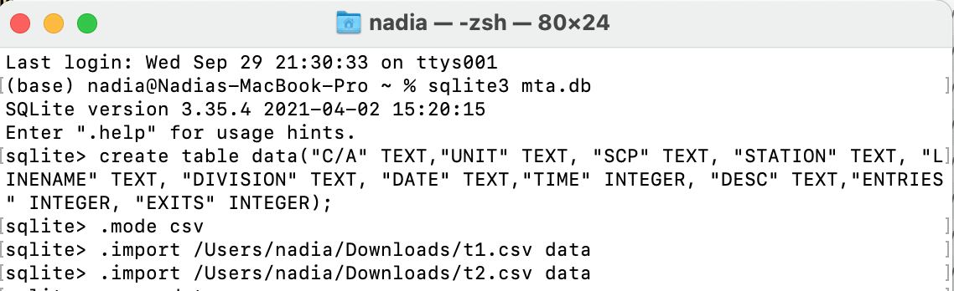
Methodology
1. Source the data : - " MTA Turnstile " website [ “ 29 May 2021 - 27 August 2021 “ ]
2. Loading the data :
1- Creating local database using SQLite .
2- Delete duplicated columns names using DB browser .
3- Read it on Jupyter notebook using “ Sqlalchemy “ library and started exploring data .

Slide 5
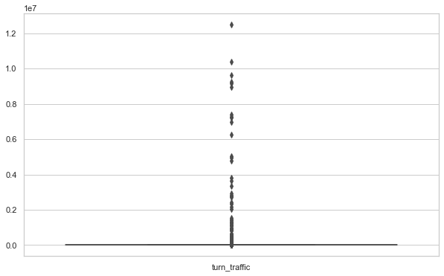
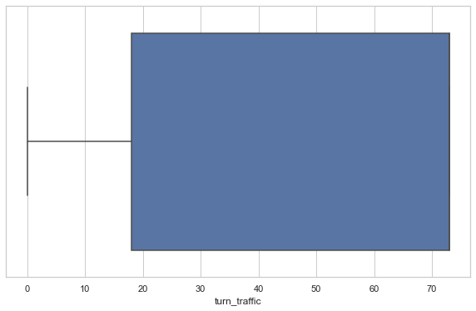
3. Cleaning the data :
Checking for nulls, outliers and duplicates then drop them .
Combining Date and time columns .
Getting total turnstile traffic out of entries and exits .
Drop unnecessary column .
Add week days column .
Before
After

Slide 6
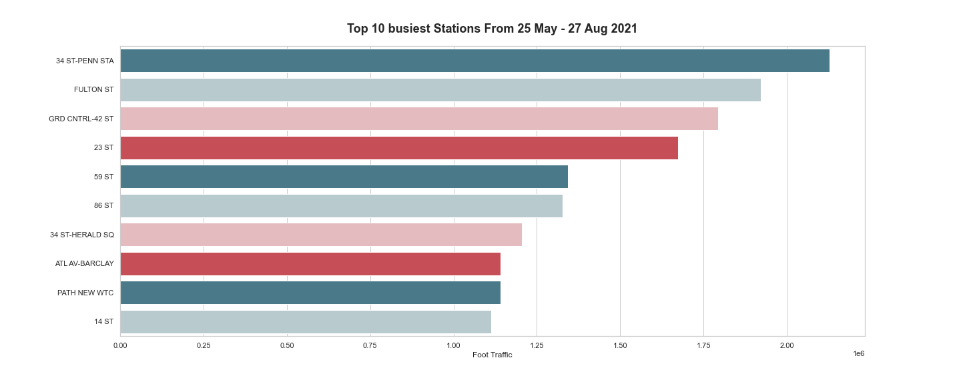
Results
1- The top busiest stations by daily average

Slide 7
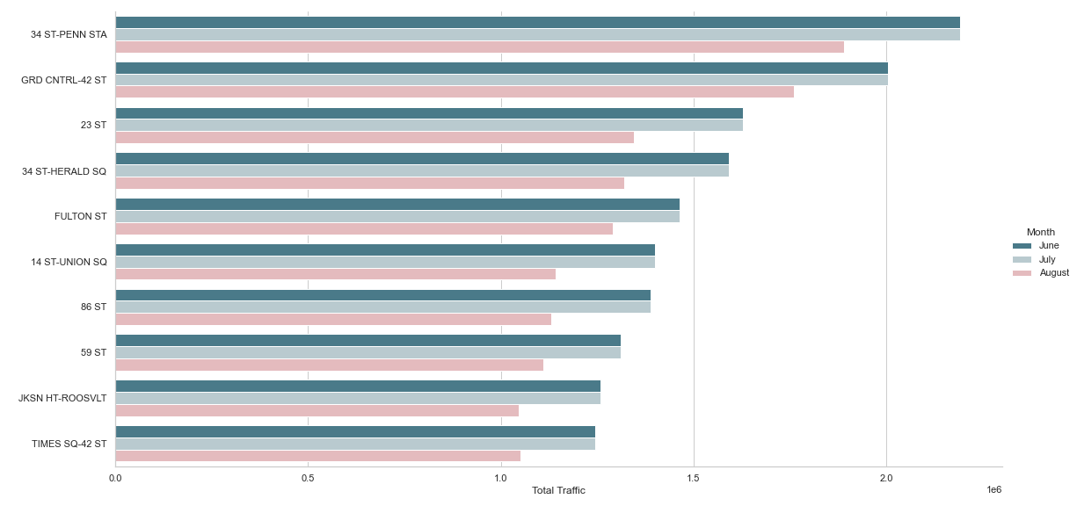
2- The busiest stations for each month

Slide 8
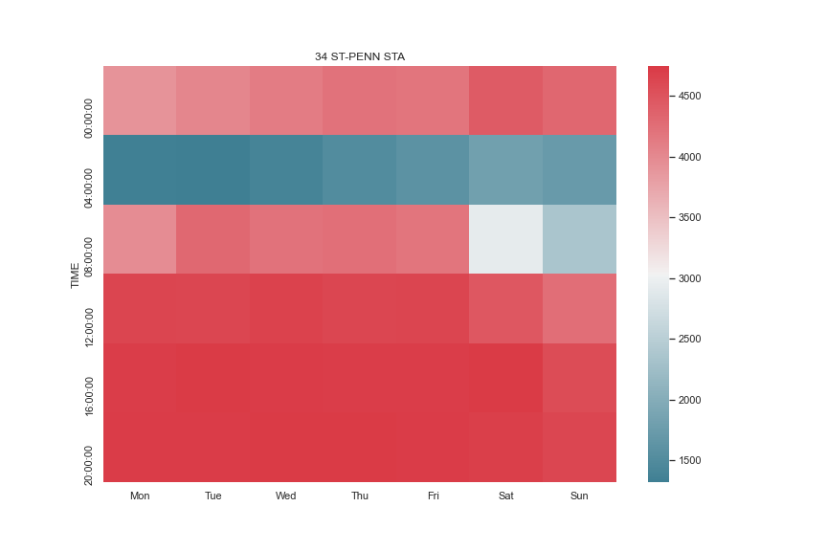
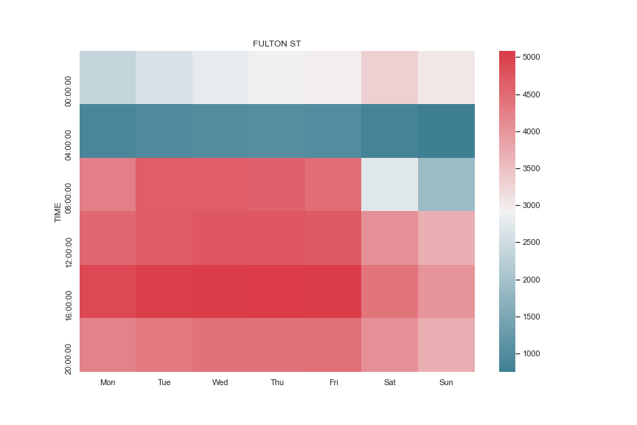
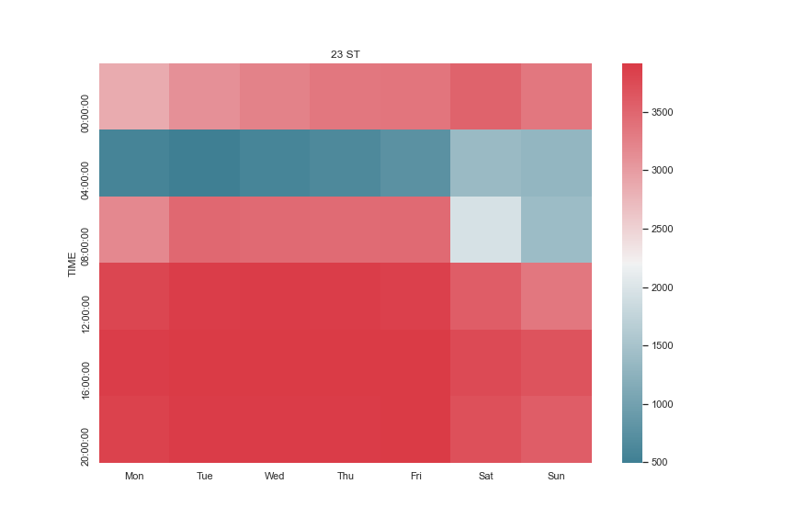
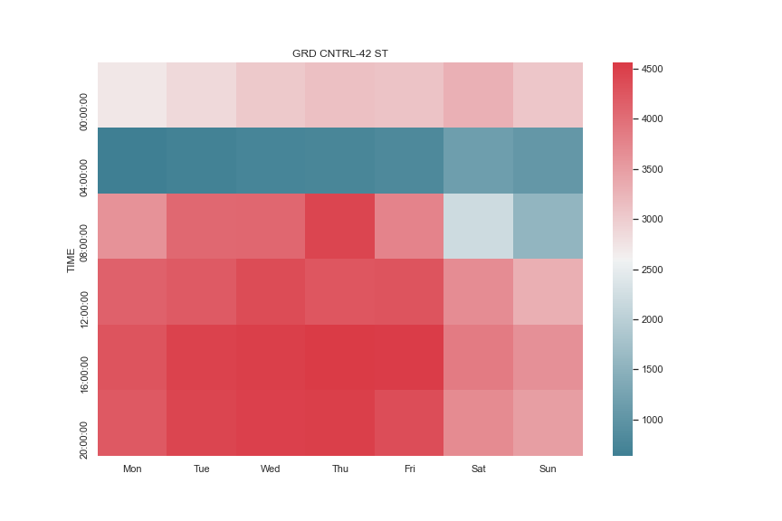
3- Busiest Hours for top 4 stations in terms of traffic

Slide 9
Recommendations
I recommend targeting stations that have a high traffic to maximize the number of sign-ups people to attend the gala. Based on this criteria :
34 St-Penn STA from Monday through Friday between ( 8:00 am – 8:00 pm )
& Saturday between ( 12:00 pm – 8:00 pm ) .
FULTON ST from Monday through Friday between ( 12:00 pm – 4:00 pm ) .
23 ST from Monday through Friday between ( 8:00 am – 8:00 pm ) .
GRD CNTRL-42 ST from Monday through Friday from ( 12:00 pm – 8:00 pm ) & Thursday from ( 4:00 am – 8:00 am ) .

Slide 10
Thank you for your kind attention

